Slide 1


Common Cloud Operations in Microsoft Azure and AWS
Tim Warner

Slide 2

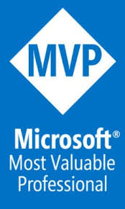

Tim Warner
Based in Nashville, TN, US
MCT, MVP
Twitter: @TechTrainerTim
Badge: TechTrainerTim.com

Slide 3
Session 1 of 2 Learning Goals
Introduction
General comparisons
Storage
Compute

Slide 4
Session 2 of 2 Learning Goals
Networking
Security
Monitoring
Pricing

Slide 5
Course Materials
timw.info/azureaws

Slide 6
Setting Expectations
10-minute break at midpoint
Please ask/answer questions and provide feedback in the Q/A panel, not the group chat
I'll post outstanding questions/answers to my Twitter feed: @TechTrainerTim

Slide 7
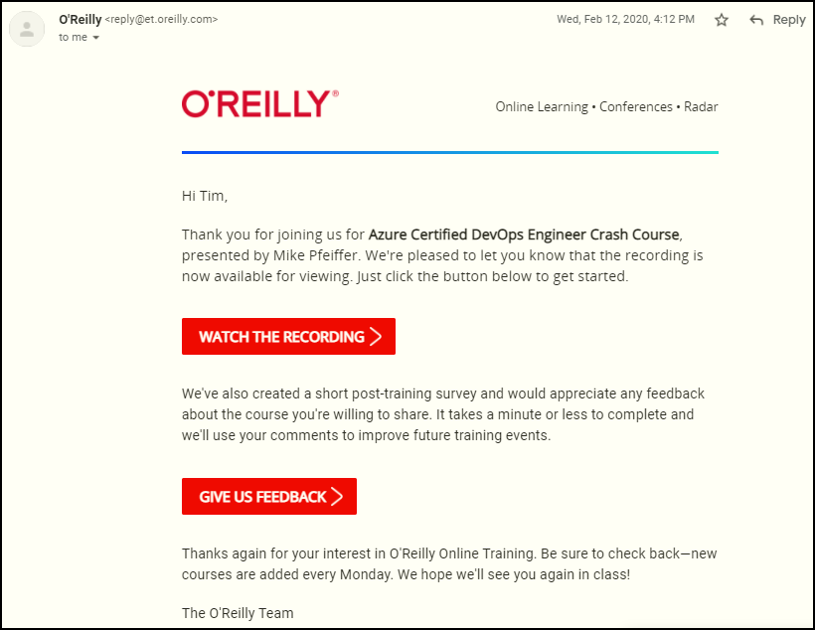
Session Recordings

Slide 8

Session Recordings

Slide 9

Session Recordings

Slide 10


Session Recordings

Slide 11
Thank you!
Course materials: timw.info/az400
Twitter: @TechTrainerTim
Work: timw.info/ps
Web: TechTrainerTim.com

Slide 12
Title

Slide 13
Title

Slide 14
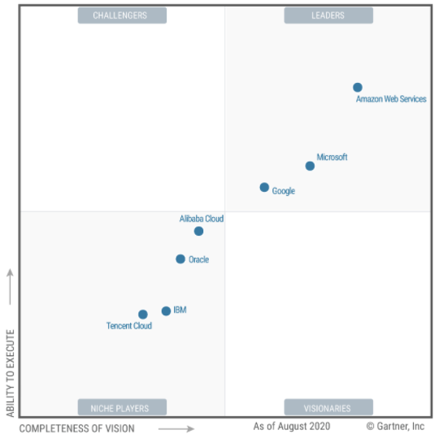
Gartner Magic Quadrant 2020
https://timw.info/ea056

Slide 15

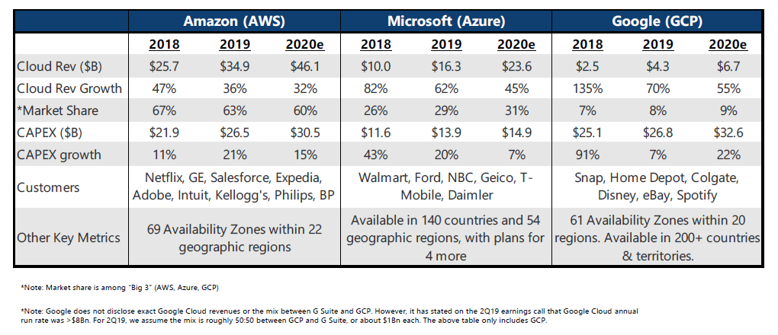
Revenue and Market Share (ZDNet)
https://timw.info/fa5a6

Slide 16




Amazon Web Services - Timeline
April 2015: Machine learning
Jan 2012: DynamoDB
Oct 2009: RDS
Nov 2008: CloudFront CDN
Aug 2008: EBS
Aug 2006: EC2
March 2006: Launch, S3

Slide 17

Microsoft Azure - Timeline
April 2014: Rename to Microsoft Azure; Azure Resource Manager (ARM)
June 2012: Websites, VMs, new portal
Feb 2010: Commercial availability
Nov 2009: PHP, Java
Mar 2009: SQL Azure; websites
Oct 2008: Initial announcement

Slide 18
Management Interfaces
Web Portal
Azure Portal/AWS Management Console
REST APIs
Azure/AWS SDKs
CLI
Azure CLI/AWS CLI
PowerShell
Azure PowerShell/AWS Tools for PowerShell
JSON Templates
ARM templates/AWS CloudFormation templates

Slide 19
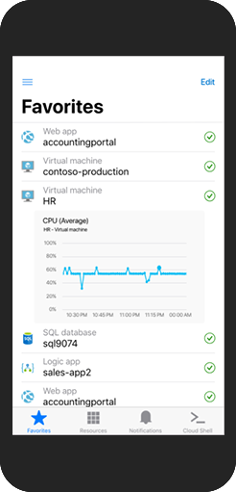
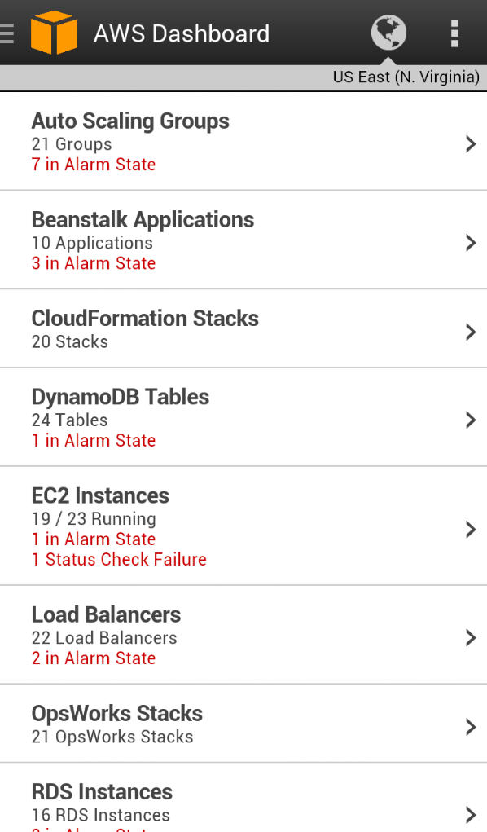
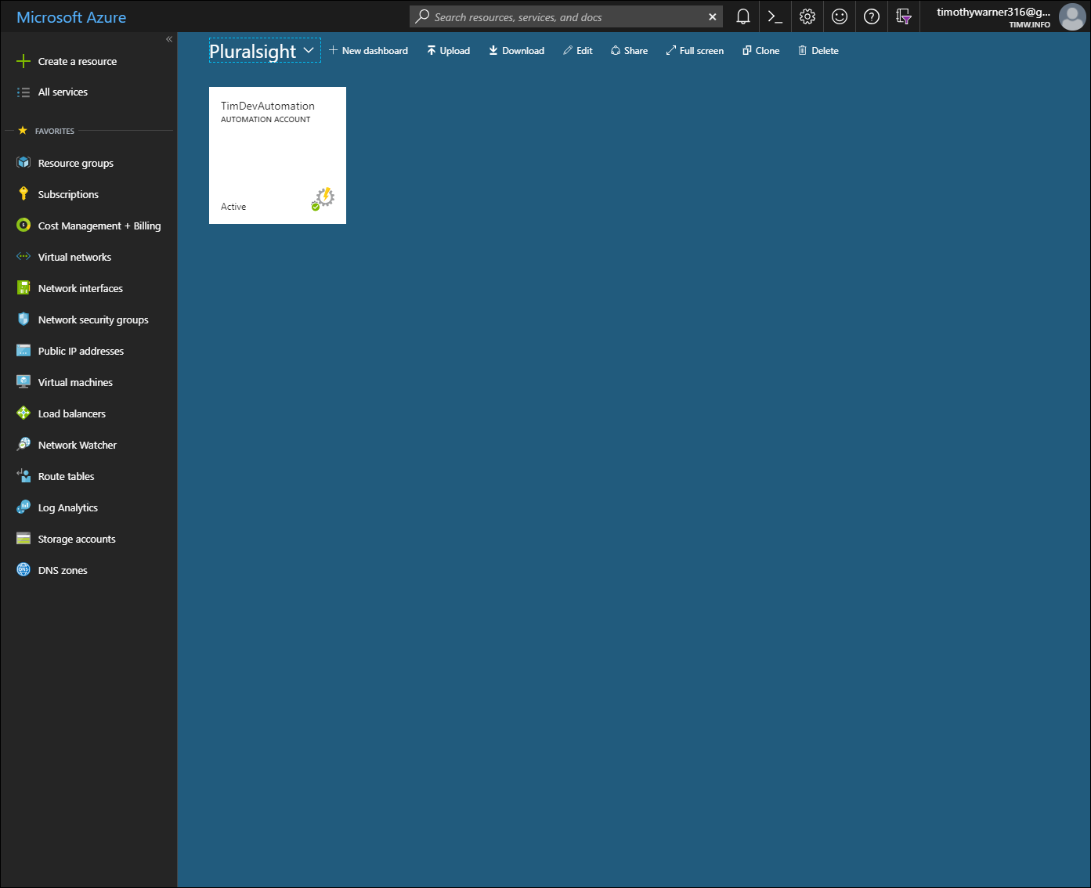
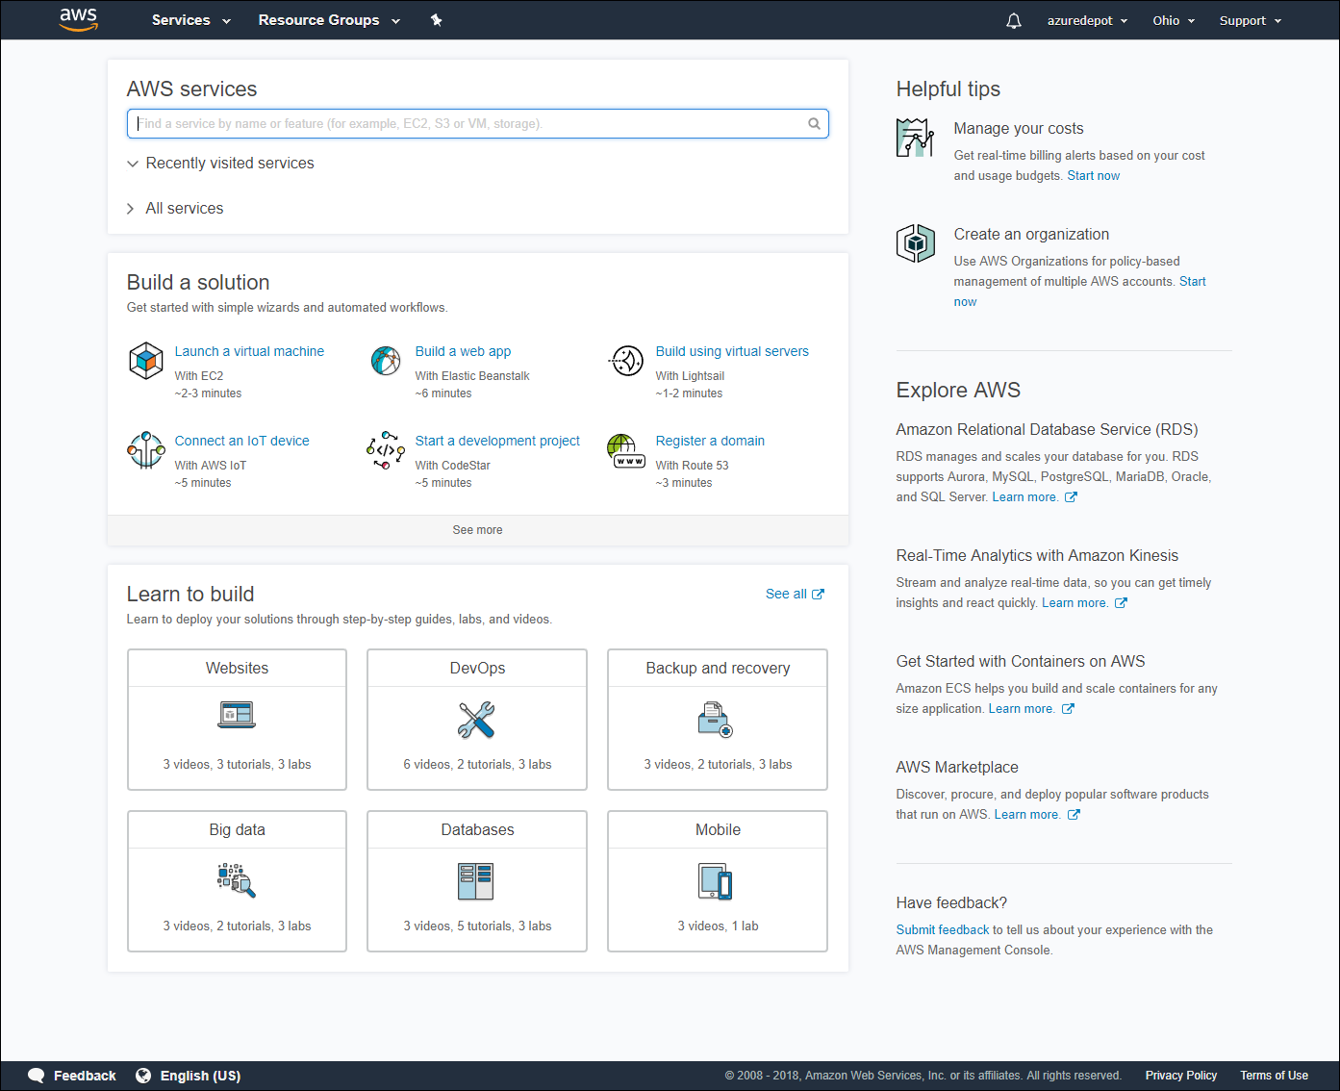
Web Management Portals
Azure
AWS

Slide 20
“It’s a pretty level playing field with management/API tools.”
Tim’s observation
Both vendors’ services are REST APIs

Slide 21
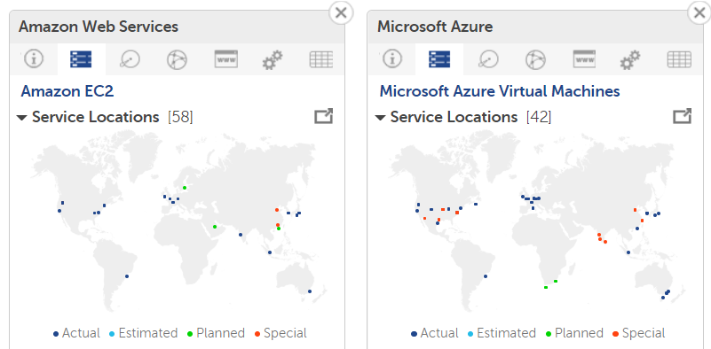
Regions
cloudharmony.com

Slide 22
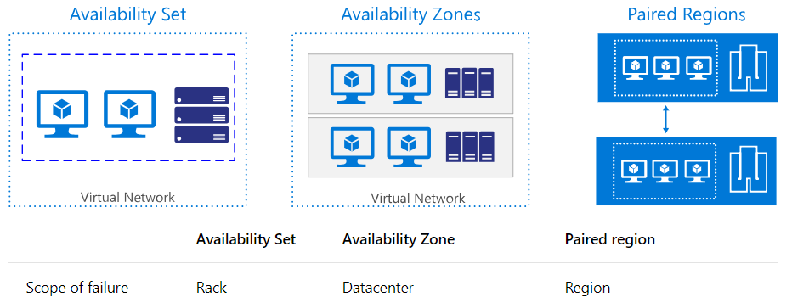
Availability Zones
Availability zones are new-ish Azure feature
Only Azure has availability sets and paired regions

Slide 23
“Historically, AWS tended to lead, and Azure tended to follow.”
Tim’s observation
Microsoft is now in full innovation mode
Good example: Azure Stack

Slide 24
“I see lots of ‘Azure for AWS professionals learning resources,’ but not the other way around.”
Tim’s observation
Microsoft looks at “competitors” as potential business partners

Slide 25
Title

Slide 26
Title

Slide 27


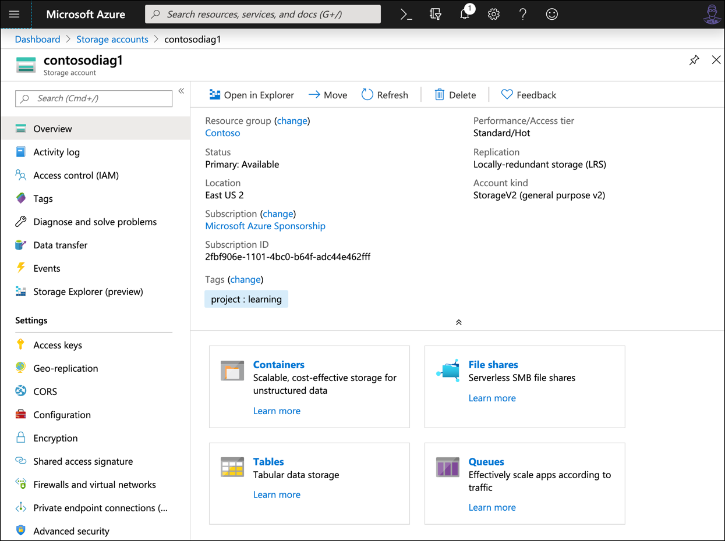
Azure Storage Account
S3
Managed disks
EBS
EFS
SQS

Slide 28


Database Options
Microsoft Azure
Amazon Web Services
Azure SQL Database
Azure Database for MySQL
Azure Database for PostgreSQL
Azure SQL Database Managed Instance
Azure Cosmos DB
Azure Database Migration Service
Relational Database Service (RDS)
DynamoDB, SimpleDB
AWS Database Migration Service

Slide 29




Storage Shake-out
Feature | Azure | AWS
VM disk storage | Managed disks | EBS
VM backup | Azure Backup | None
DR | ASR | Non
Block storage (including hot, cool, and cold tiers) | S3; Glacier | Azure Storage
Hybrid storage | Storage Gateway | StorSimple
Bulk data transfer | AWS Snowball | Azure Data Box

Slide 30
“One differentiator is that many businesses make their living with the AWS S3 APIs.”
Tim’s observation

Slide 31
“Microsoft gives you lots of built-in backup flexibility; AWS seems to leave DR to third-party partners.”
Microsoft focuses on end-to-end IaaS lifecycle
Tim’s observation
AWS focuses on exposing APIs to developers

Slide 32


Relational Databases
Azure
AWS
Azure SQL Database
Azure SQL DB Managed Instance
Azure DB for MySQL
Azure DB for PostgreSQL
RDS
Amazon Aurora
PostgreSQL
MySQL
MariaDB
Oracle
SQL Server

Slide 33


Non-Relational Databases
Azure
AWS
Cosmos DB (Multi-model)
Azure Redis Cache
Dynamo DB (document)
SimpleDB (key-value)
ElastiCache

Slide 34
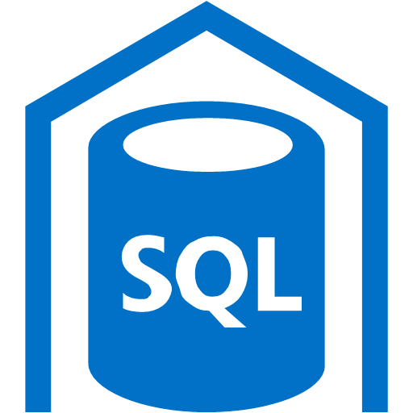

Big Data
Azure
AWS
SQL Data Warehouse
HDInsight
Data Factory
Data Lake
Redshift
Elastic MapReduce (EMR)
Data Pipeline
Kinesis Analytics

Slide 35
Title

Slide 36
Title

Slide 37


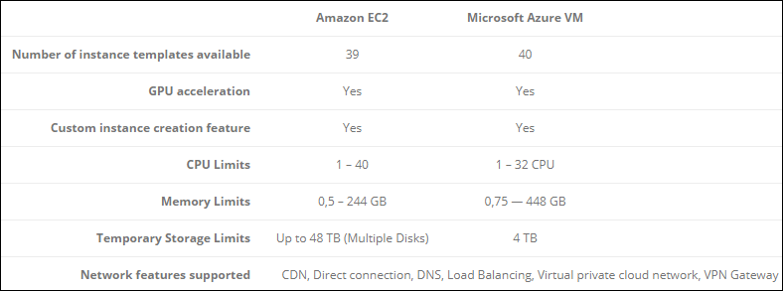
Amazon EC2 vs. Azure VM
timw.info/cb1

Slide 38


Container instances (EC2 Container Service vs. Azure Container Instances)
Container orchestration (EKS vs. AKS)
Serverless compute (Lambda vs. Azure Functions)
Other Compute Layers

Slide 39
“If you run Windows, you’ll get better pricing with Azure because Microsoft owns the technology.”
Tim’s observation

Slide 40
“If you are looking for IaaS depth and flexibility, AWS hasd an advantage.”
Tim’s observation
The learning curve is steep, especially for developers

Slide 41
Microsoft sunsetted RemoteApp in Azure
They directed you to Citrix XenApp or RDS as IaaS VMs
Now we have Windows Virtual Desktop (WVD)
AWS Workspaces
App/Desktop Virtualization

Slide 42


Network Technology
Azure
AWS
Virtual network
Network security groups
AWS VPN Gateway
Virtual Private Cloud (VPC)
Security groups
Azure VPN Gateway

Slide 43


Hybrid Cloud Differentiation
Azure
AWS
Azure AD Connect
Active Directory Federation Services (AD FS)
Azure Stack
AWS Directory Service
AD Connector

Slide 44
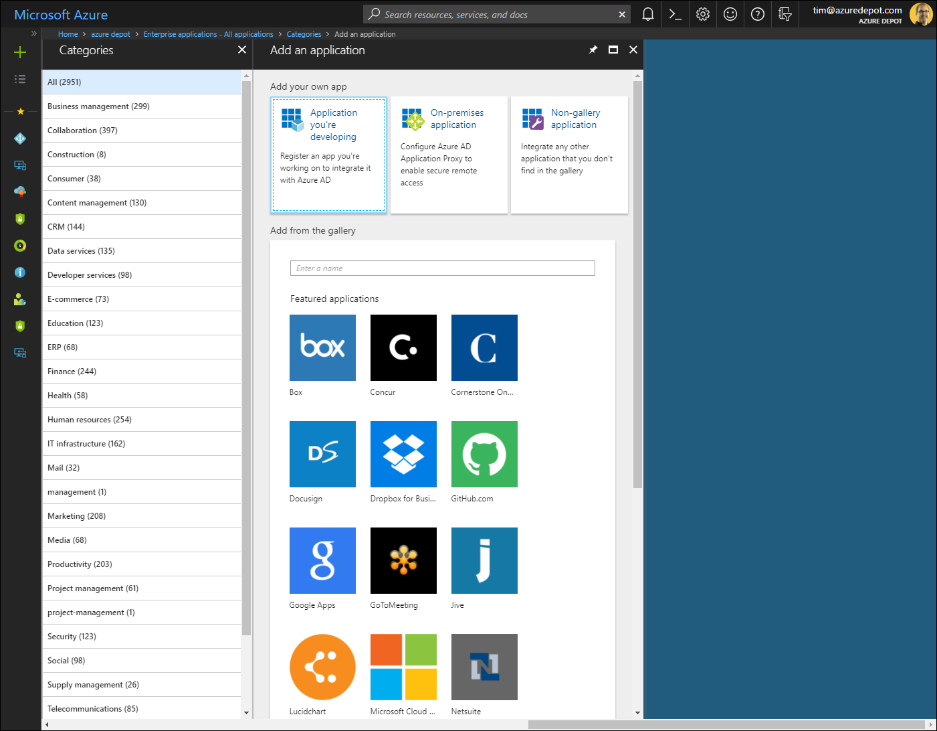
Azure SaaS SSO Integrations

Slide 45
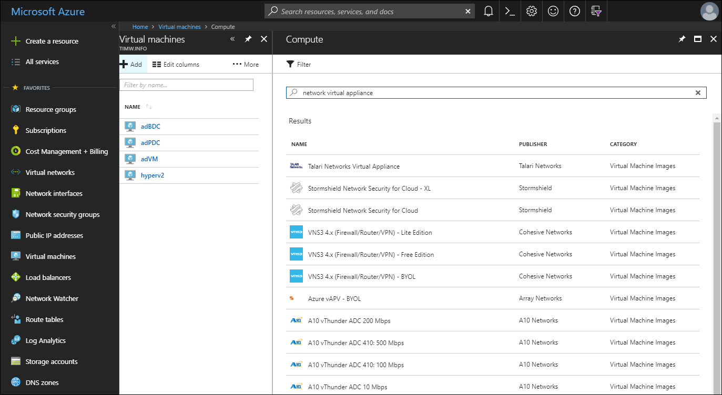
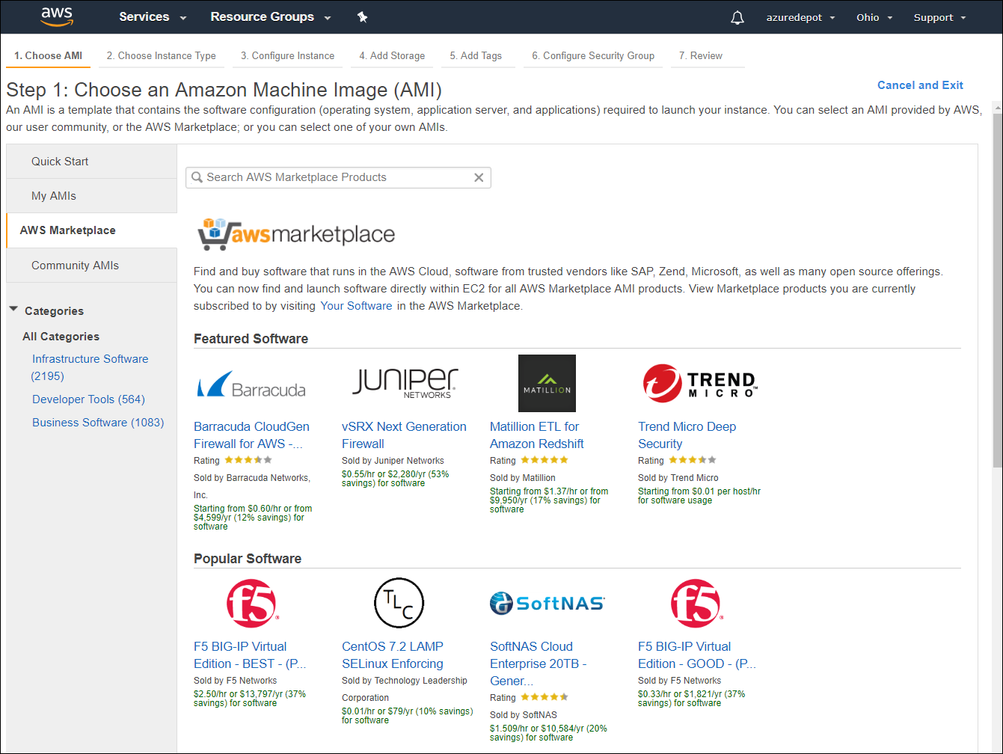
Marketplace/Network Virtual Appliances
Azure
AWS

Slide 46
“AWS initially missed the boat on hybrid cloud.”
VMware Cloud on AWS
Tim’s observation
Azure VMware Solution

Slide 47
“Azure AD makes for a powerful and compelling app identity solution.”
AWS Simple AD (LDAP)
Tim’s observation
AWS Directory Service (Kerberos)

Slide 48
Title

Slide 49
Title

Slide 50
Title

Slide 51
Title

Slide 52
Title

Slide 53
Title

Slide 54
Title

Slide 55
Title

Slide 56
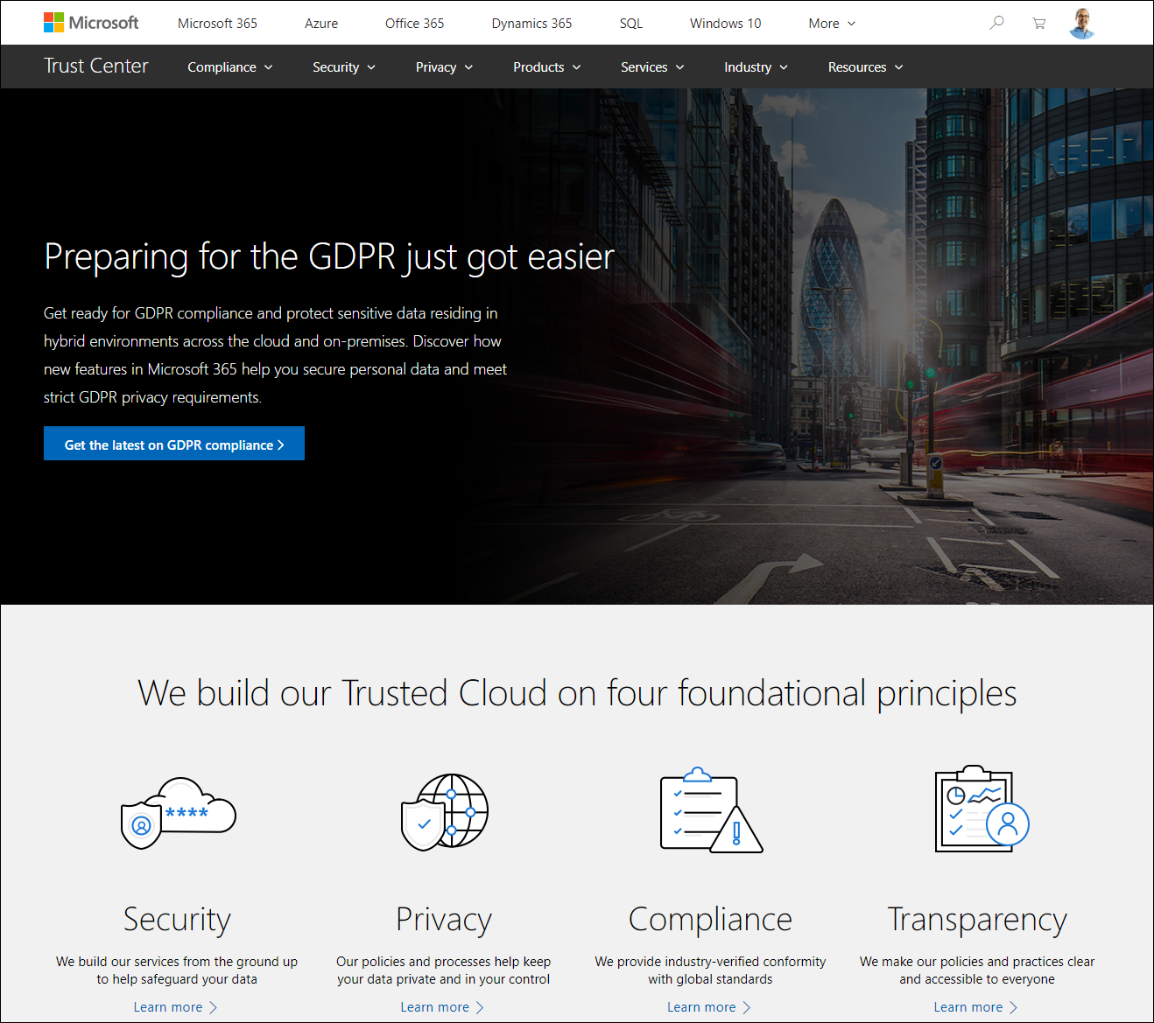
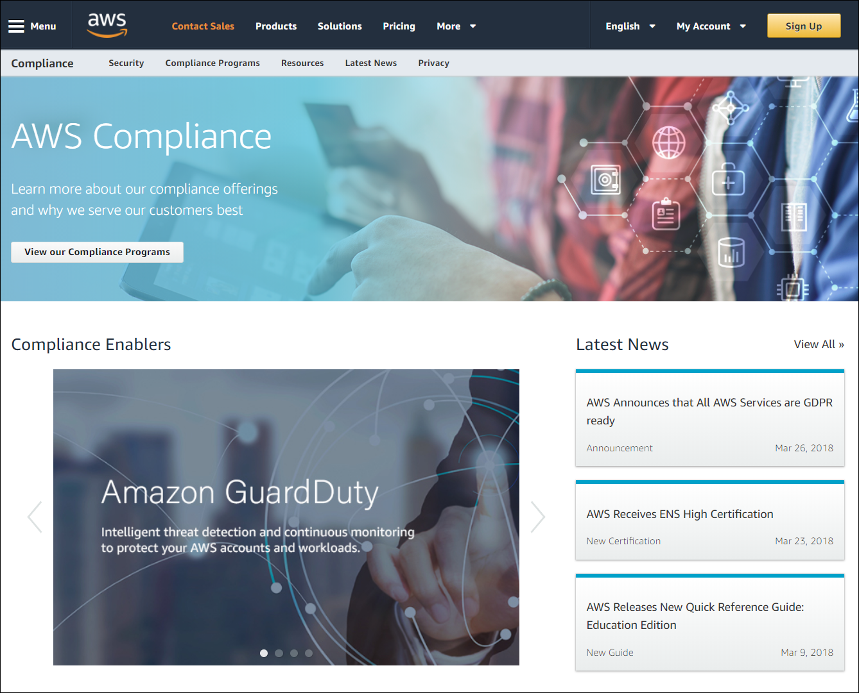
Compliance and Trust
Azure
AWS
timw.info/zkb
timw.info/hwl

Slide 57
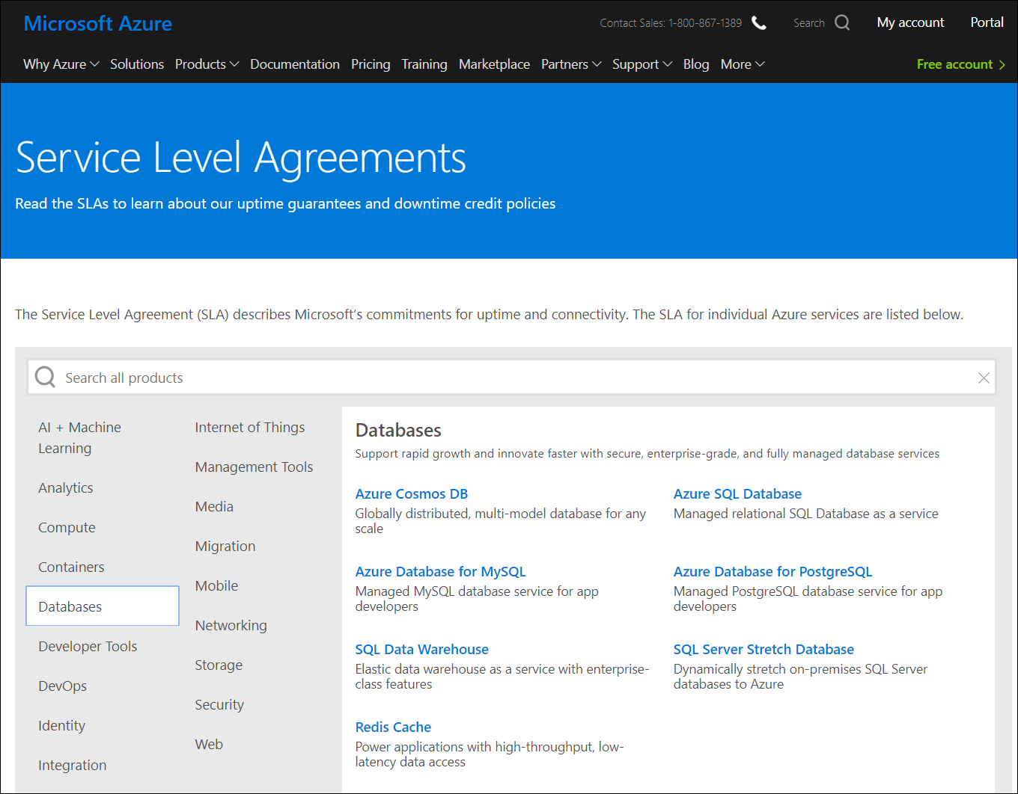
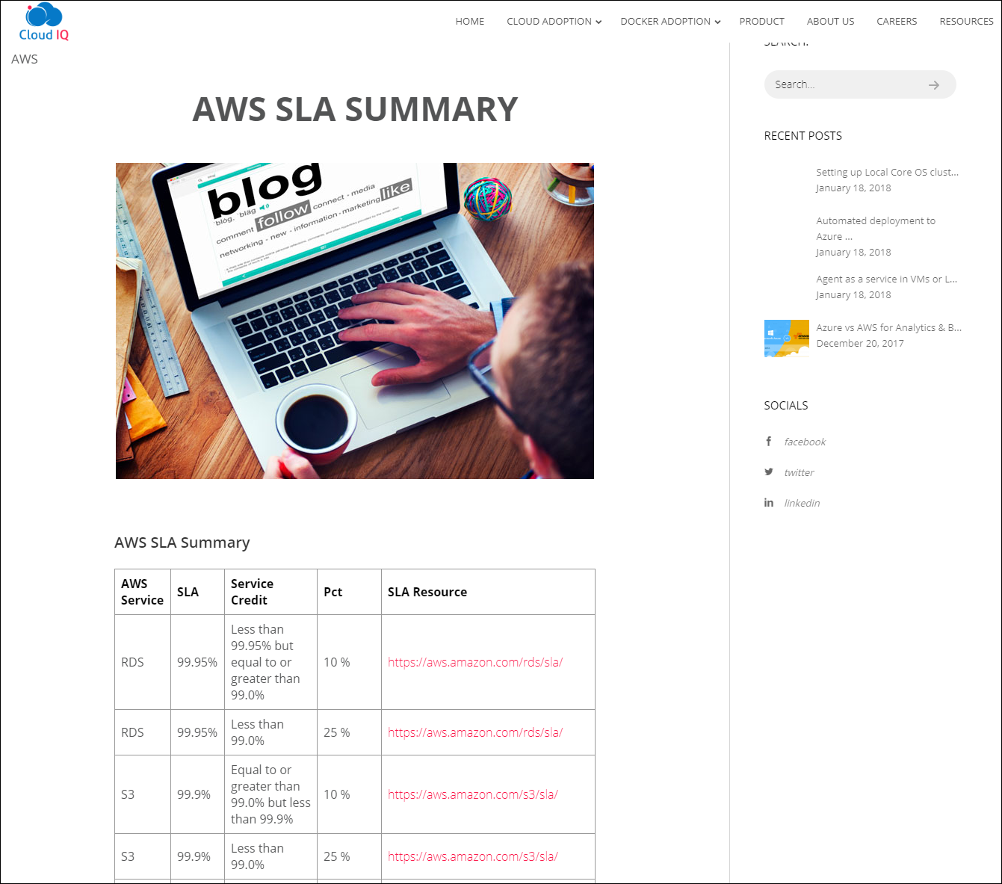
Service-Level Agreements (SLAs)
Azure
AWS
timw.info/sla1
timw.info/qaw

Slide 58
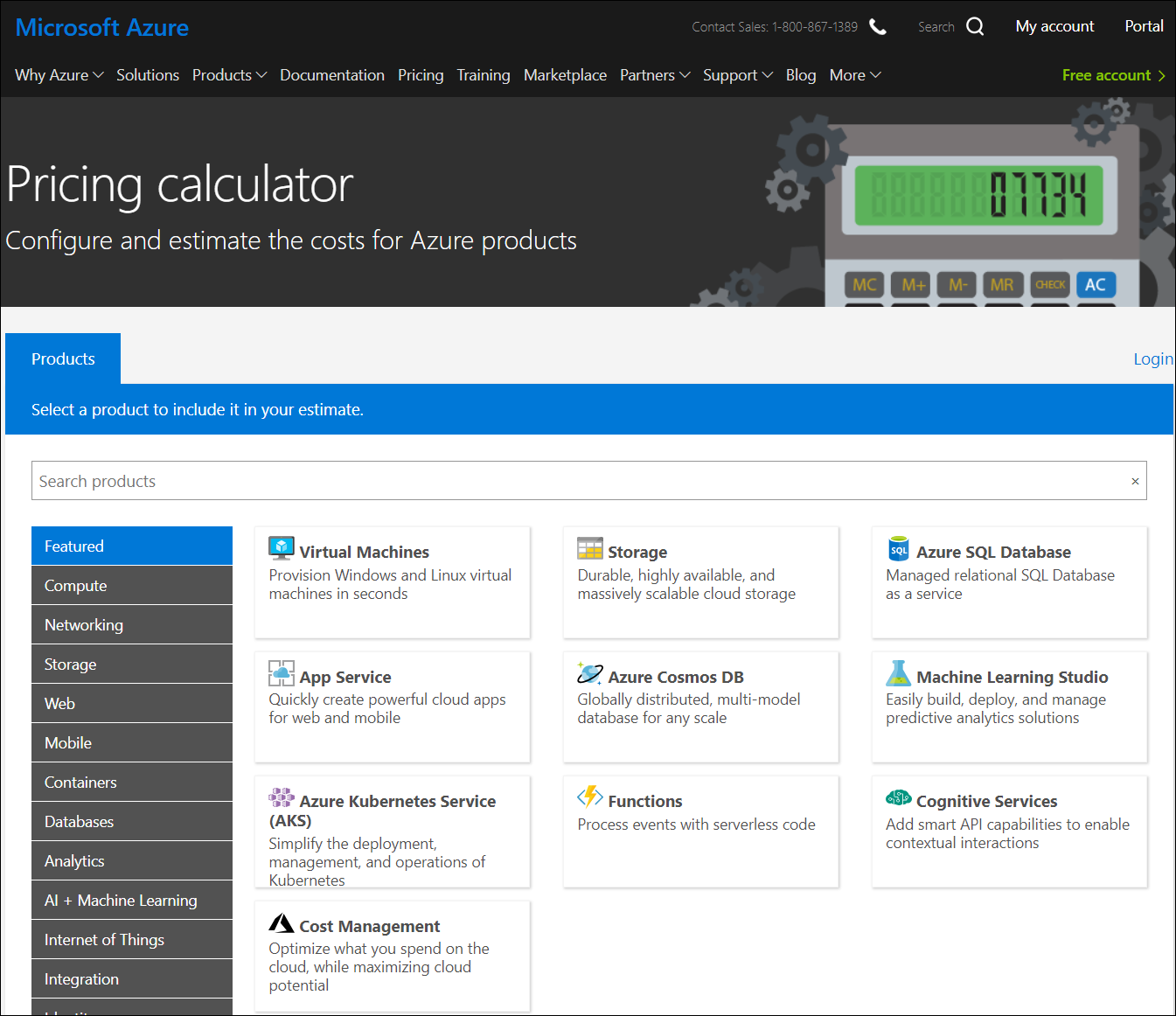
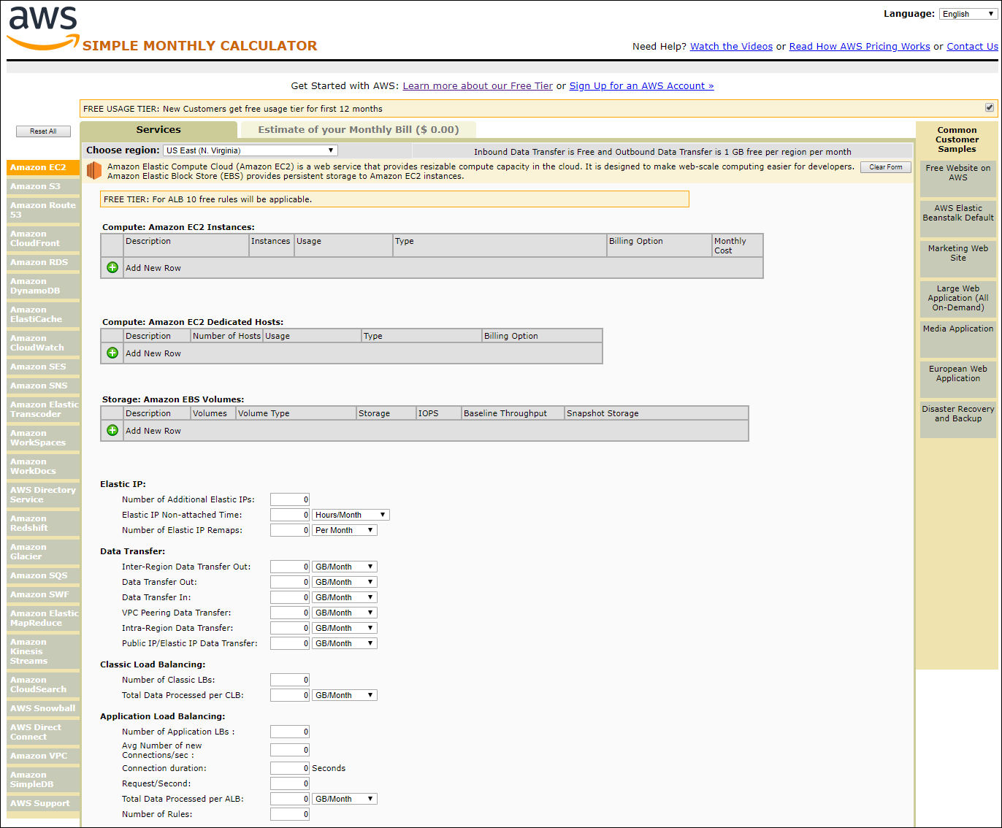
Cloud Calculators
Azure
AWS

Slide 59
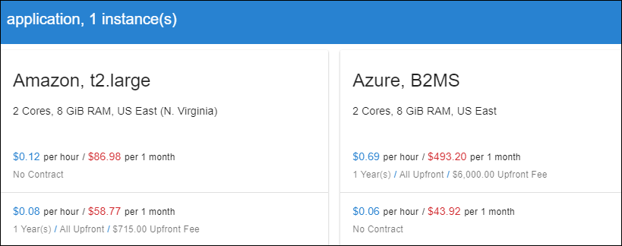

calculator.unigma.com
Both clouds have reserved instance pricing

